Slide 1

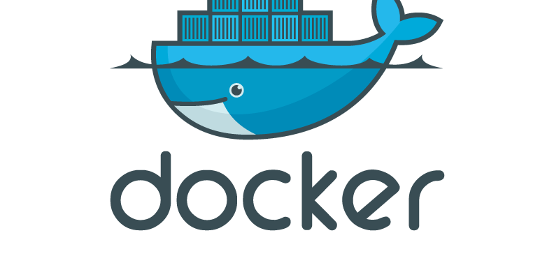

Slide 2
Outline
Introduction
Installing Docker
Using Docker
Building Docker images
Orchestration

Slide 3
Docker
What docker Does
Carves up a computer into sealed containers that run your code
Gets the code to and from your computer
Builds these containers for you
Is a social platform for you to find ans share containers, witch are different form Virtual machines
What is a container
A self-contained sealed unit of software
Contains everything required to tun the code
Include batteries and operating system
A container includes :
Code, config, Processes ,Networking , Dependencies and just enough of the operating system to run the code

Slide 4
Docker
Linux Server
Virtual Network
Virtual Network
Red hat
server
Ubuntu
Server
SUSE
Server
Debian
Server
Application Server
Cache Server
Identity Server
Data Base

Slide 5
Docker
Docker is a client program, named Docker, it's a command you type at the terminal.
It's also a server program that listens for messages from that command, and manages a running Linux system
Docker has a program which builds containers from code. It takes your code along with its dependencies and bundles it up and then seals it into a container
And it's a service that distributes these containers across the internet and makes it so you can find other's work, and the right people can find your work
It is also a company that makes all of these

Slide 6
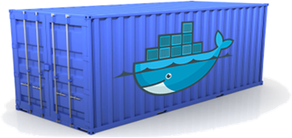
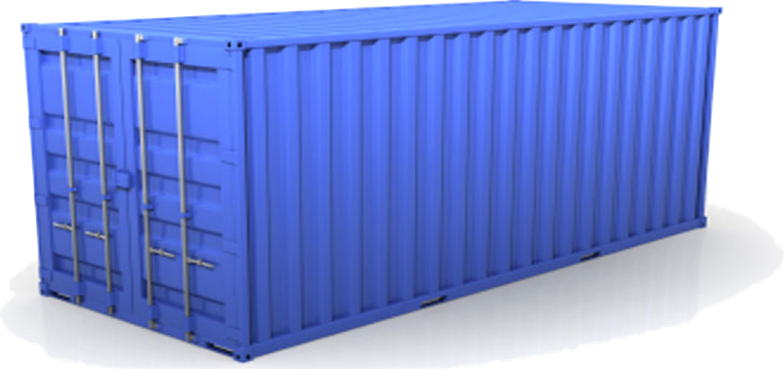
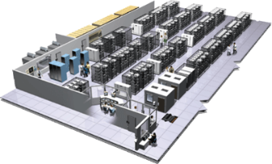
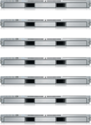
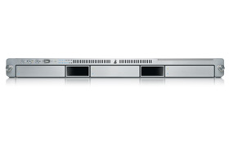
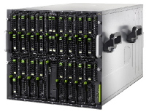


Docker is a shipping container system for code
Static website
User DB
Web frontend
Queue
Analytics DB
Do services and apps interact appropriately?
Multiplicity of Stacks
An engine that enables any payload to be encapsulated as a lightweight, portable, self-sufficient container…
…that can be manipulated using standard operations and run consistently on virtually any hardware platform
Multiplicity of hardware environments
Can I migrate smoothly and quickly
Development VM
QA server
Customer Data Center
Public Cloud
Production Cluster
Contributor’s laptop

Slide 7

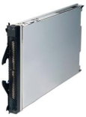
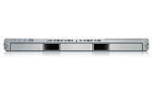
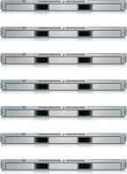


Docker eliminates the matrix from Hell
Static website
Web frontend
Background workers
User DB
Analytics DB
Queue
 | Development VM | QA Server | Single Prod Server | Onsite Cluster | Public Cloud | Contributor’s laptop | Customer Servers

Slide 8
Containers vs. VMs
App
A
App
A’
App
B
Containers are isolated,
but share OS and, where
appropriate, bins/libraries
Bins/
Libs
Bins/
Libs
Bins/
Libs
…result is significantly faster deployment, much less overhead, easier migration, faster restart
VM
Guest
OS
Guest
OS
Guest
OS
Guest
OS
Guest
OS
App A
App A’
App B
App B’
App B’
App B’
Container
Docker
Hypervisor (Type 2)
Bins/Libs
Bins/Libs
Host OS
Host OS
Server
Server

Slide 9
Installing Docker on your machine
For Docker Desktop to function correctly, your machine must have the following features:
Hyper-V installed and working
Virtualization enabled
https://docs.docker.com/docker-for-windows/troubleshoot/#virtualization-must-be-enabled
To install docker on windows 10 , please follow the steps in the link bellow
https://docs.docker.com/docker-for-windows/install/
Check docker installation , open a power shell as Administrator and run following commands
Docker info
Docker version

Slide 10
The docker flow
Commands
Docker images
docker pull ubuntu:latest
Container
File
Image
Container

Slide 11
The docker flow
Container A
Image A
Container
Docker Run
Docker Run
File
Stop container
Container A`
Image A`
Container
Docker Run
Docker commit
File
File
File

Slide 12
Running things in docker
Containers have a main process
Containers stop when the main process stops
Containers have names

Slide 13

Running things in docker
Detached containers
Interactive containers
Detach with Control p Control q
Docker ps
Docker attach container_name
Docker exec : start another process in the starting container ‘Great for debugging as db Administration’

Slide 14
Looking at containers output
Docker logs
Keep the output of the containers
View with docker logs container_name
Don’t let the output get too large
Killing and removing containers
Docker kill container_name
Docker rm container_name

Slide 15

Resources Constraints
Memory limits
Docker run –memory maximum-allowed-memory image-name command
CPU limit
Docker run –cpu-shares relative to other containers
Docker run –cpu-quota to limit it in general

Slide 16


Container Networking
Programs in containers are isolated from the internet by default
You can group your containers into private networks
You explicitly choose who can connect to whom
Expose port to let connection in
Specifies the port inside and outside the container
Expose as many port as you want
Requires coordination between containers
Private networks connect between containers
UDP/TCP
Docker run –p outside-port:inside-port / (UDP/TCP)

Slide 17

Exposing port dynamiclly
The port inside the container is fixed
The port on the host is chosen from the unused ports
This allows many containers running programs with fixed ports
This often is used with a service discovery

Slide 18
Container Networking
Host network
Virtual network
Client container
Server container

Slide 19
Container Networking
Bridge
Only containers in the same network can connect with each others
Host
Containers don’t have any network isolation
None
Containers should not have no networking

Slide 20
Container Networking
Catonly network
learning network
bobCatserver container
Catserver container
Dogserver container

Slide 21

Docker images
Docker images : list of images in your local machine
Docker Tag ; give the name to your images
Docker commit : create a new image ,it can give the name to the image
The tag name : organisation/image-name ➔ organisation name of your DCR ‘Docker container registry’
Docker push : push an image to the DCR ‘Docker hub or other private DCR’
Docker rmi : remove image form the local machine
Docker Pull to download images form the DCR

Slide 22
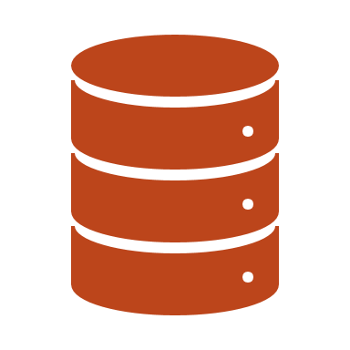
Docker Volumes
Virtual « discs» to store and share data
Two main varieties
Persistent
Ephermeral
Not part of images
Volaumes are used to share data between container and host machine ( the whole folder or only single file)

Slide 23
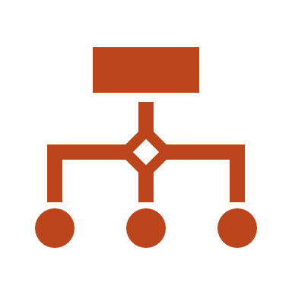
Sharing data between containers
Volumes_from : command
Shared discs that exist only as long they are being used
Can be shared between containers

Slide 24
Docker File
Is used to build images form code
It describes how to build an image
Run with this command : docker build –t name-of-the-result:tag . ⬅ Context
The result is in your local docker registry (local machine)

Slide 25
What are the basics of the Docker system?
Container A
Docker
Container
Image Registry
Push
Search
Pull
Source Code Repository
Run
Build
Dockerfile
For
A
Container A
Container B
Container C
Docker
Docker Engine
Host 1 OS (Linux)
Host 2 OS (Linux)

Slide 26
Changes and Updates
Docker
Container
Image Registry
App
A
Push
App Δ
Bins/
Libs
Bins/
Base
Container
Image
Container Mod A’
Container Mod A’’
App Δ
Update
App
A
Bins/
App
A’’
Bins/
Libs
Bins/
Libs
Bins/
Docker Engine
Docker Engine
Host is now running A’’
Host running A wants to upgrade to A’’. Requests update. Gets only diffs

Slide 27
Orchestration
Many orchestration systems for docker
Start containers ---- and restart them if they fail
Service discovery --- allow them to find each other
Resource allocation --- match containers to computes

Slide 28
Docker compose
Single machine coordination
Designed for testing and development machine
Bring up all your containers , volumes , network with one command
docker-compose up

Slide 29
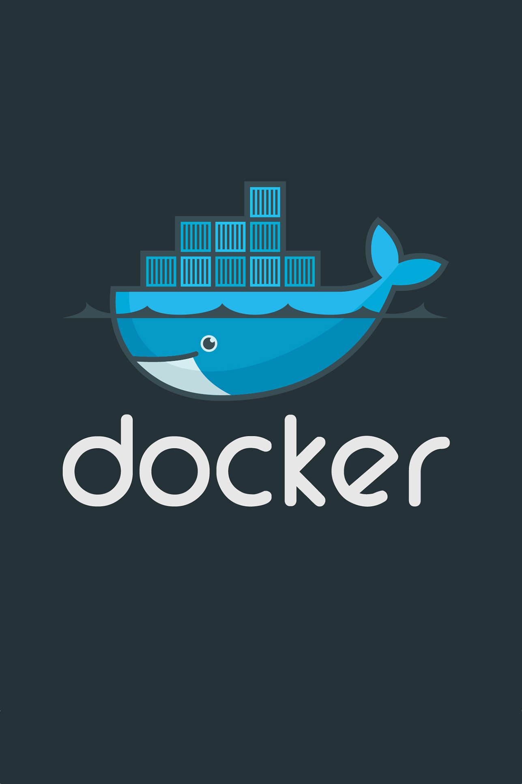
What has Docker Done for Us?
Continuous delivery
Deliver software more often and with less errors
No time spent on dev-to-ops handoffs
Improved Security
Containers help isolate each part of your system and provides better control of each component of your system
Run anything, anywhere
All languages, all databases, all operating systems
Any distribution, any cloud, any machine
Reproducibility
Reduces the times we say “it worked on my machine”

Slide 30
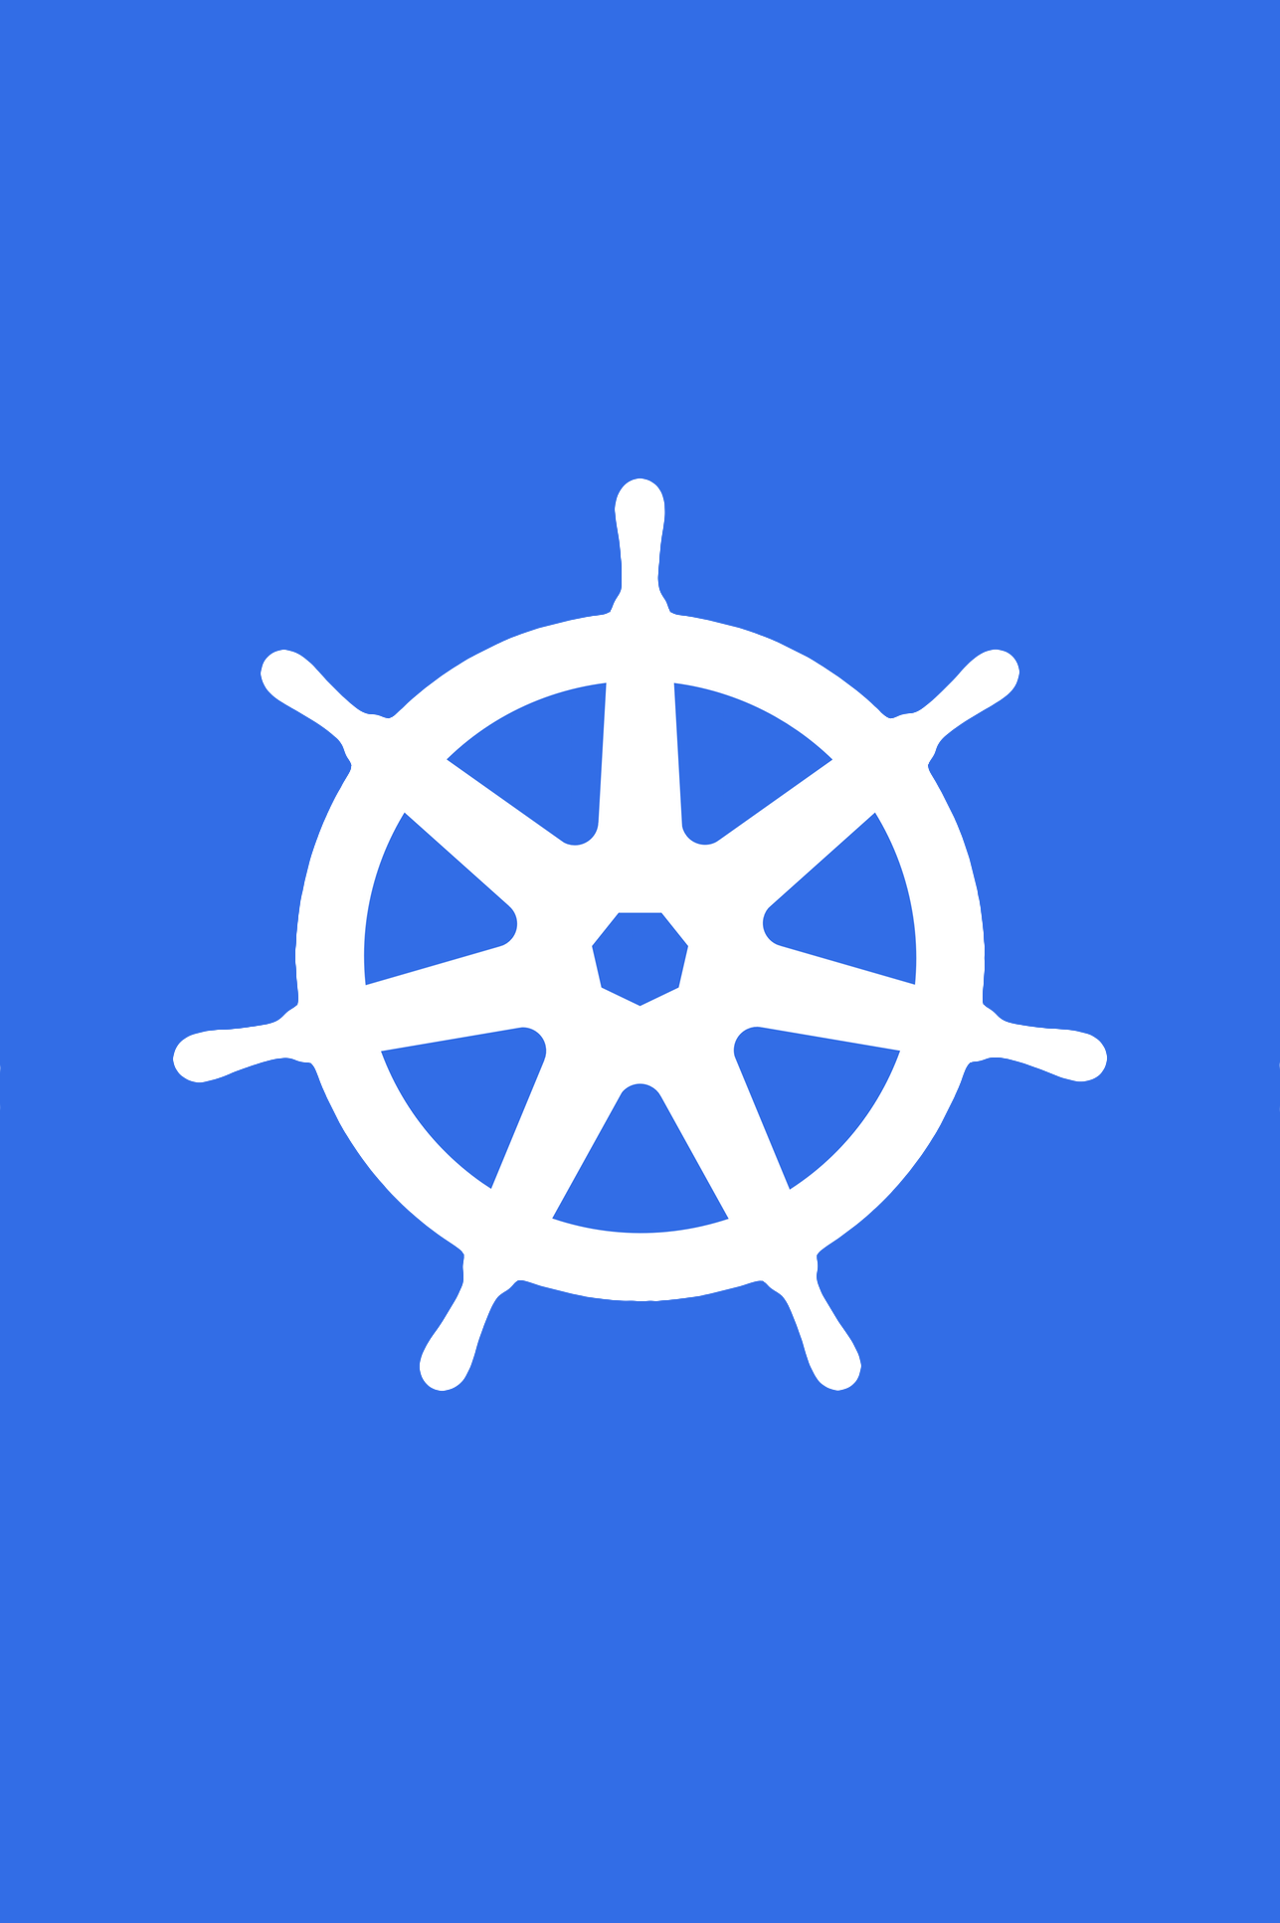
What Does Kubernetes do?
Kubernetes is an open-source system for automating deployment, scaling, and management of containerized applications.
Improves reliability
Continuously monitors and manages your containers
Will scale your application to handle changes in load
Better use of infrastructure resources
Helps reduce infrastructure requirements by gracefully scaling up and down your entire platform
Coordinates what containers run where and when across your system
Easily coordinate deployments of your system
Which containers need to be deployed
Where should the containers be deployed

